Slide 1
Digital Signal Processing(BEC-303)
Unit-1
Lecture-1
(Basic Concepts of Signal and System)
Presented By:
Dr. Dr. Ishwar Chandra Yadav

Slide 2
Course Outcomes
Able to analyze signals using the Discrete Fourier Transform and Fast Fourier Transform.
Able to understand the characteristics of infinite impulse response (IIR) filters and learn designing IIR filters for filtering undesired signals.
Able to understand the characteristics of finite impulse response (FIR) filters and learn designing FIR filters for filtering undesired signals.
Able to implement digital filters in a variety of forms:-Direct form I & II, Parallel, Cascade and lattice structure.

Slide 3
Syllabus
Unit-1
Discrete Fourier Transforms: Definitions, Properties of the DFT
Circular Convolution, Linear Convolution
Fast Fourier Transform Algorithms: Introduction
Decimation in Frequency (DIF) Algorithm
Decimation in Time (DIT) Algorithm, Computational Efficiency

Slide 4
Syllabus (Cont..)
Unit-2
LPF, HPF, BPF, BRF filter design using frequency translation
Approximation of derivatives
IIR Filter Design: Structures of IIR, Analog filter design
Discrete time IIR filter from analog filter: IIR filter design by Impulse Invariance
Bilinear transformation

Slide 5
Syllabus (Cont..)
Unit-3
FIR Filter Design: Filter design using windowing techniques: Rectangular Window
Kaiser Window
Blackman Window
Frequency sampling technique
Hamming Window and Hanning Window

Slide 6
Syllabus (Cont..)
Unit-4
Realization of Discrete Time Systems: FIR systems – Direct form, cascaded, parallel and lattice structures
Finite Word length Effects: Quantization effect in filter coefficients
Round-off effect in digital filters
IIR systems – Direct form, cascaded, parallel, lattice and lattice ladder structures

Slide 7
Books & References
John G Prokias, Dimitris G Manolakis, “Digital Signal Processing”, Pearson Education.
Oppenheim & Schafer, “Digital Signal Processing” PHI Learning Pvt Ltd.
Johnny R. Johnson, “Digital Signal Processing”, PHI Learning Pvt Ltd.
S. Salivahanan, “Digital Signal Processing” Mc Graw Hill Education
https://nptel.ac.in/courses/117/102/117102060/

Slide 8



Signal:
A signal is defined as a as any physical quantity that varies with time, space, or any other independent variable or variables.
Mathematically, a signal is described as a function of one or more independent variables.
Examples:
$$S_{1}\left(t\right)=2t$$
Continuous-Time Signal : A signal x(t) is said to be a continuous time signal if it is defined for all time t.
Discrete-Time Signal : A discrete time signal x[nT] has values specified only at discrete points in time.

Slide 9
Continuous Time Sinusoidal Signals
A simple harmonic oscillation is mathematically described as
x(t) = A Sin (ω t + θ)
This signal is completely characterized by three parameters:
A = amplitude, ω = 2πf = frequency in rad/s, and θ = phase in radians.
A
T=1/f

Slide 10
Discrete Time Sinusoidal Signals
A discrete time sinusoidal signal may be expressed as
x[n] = A Sin (ωn + θ) -∞ < n < ∞
Properties:
A discrete time sinusoid is periodic only if its frequency is a rational number.
Discrete time sinusoids whose frequencies are separated by an integer multiple of 2π are identical.
The highest rate of oscillation in a discrete time sinusoid is attained when ω = π ( or ω = -π ), or equivalently f = 1/2 (or f = -1/2).
1
0
-1
0
2
4
6
8
10

Slide 11
A system is defined as an entity that manipulates one or more signals to accomplish a function, thereby yielding new signals.
System:
Signal Processing:
A system characterized by the type of operation that it performs on the signal. For example, if the operation is linear, the system is called linear. If the operation is non-linear, the system is said to be non-linear, and so forth. Such operations are usually referred to as “Signal Processing”.

Slide 12
Basic Elements of a Signal Processing System
Analog input
signal
Analog output
signal
Analog
Signal Processor
Analog Signal Processing
Analog
input
signal
Analog
output
signal
A/D
converter
Digital
Signal Processor
D/A
converter
Digital Signal Processing

Slide 13
Advantages of Digital over Analogue Signal Processing
Flexibility in reconfiguring
Better control of accuracy requirements
Easily stored on media
Implementation of more sophisticated signal processing algorithms
Repeatability
Cheaper than its analogue counterpart
Universal Compatibility
Adaptability

Slide 14
DSP Applications
Space
Space photograph enhancement
Data compression
Intelligent sensory analysis
Medical image storage and retrieval
Medical
Image and sound compression for
multimedia presentation.
Movie special effects
Video conference calling
Commercial
Video and data compression
echo reduction
signal multiplexing
filtering
Telephone

Slide 15
Classification of Signals
Deterministic and non-deterministic signals
Periodic and aperiodic signals
Even and odd signals
Causal and non-causal signal
Energy and power signals

Slide 16
Classification of Signals
Deterministic Signals
A deterministic signal behaves in a fixed known way with respect to time. Thus, it can be modeled by a known function of time t for continuous time signals, or a known function of a sampler number n, and sampling spacing T for discrete time signals.
Random or Stochastic Signal:
In many practical situations, there are signals that either cannot be described to any reasonable degree of accuracy by explicit mathematical formulas, or such a description is too complicated to be of any practical use. The lack of such a relationship implies that such signals evolve in time in an unpredictable manner. We refer to these signals as random.

Slide 17
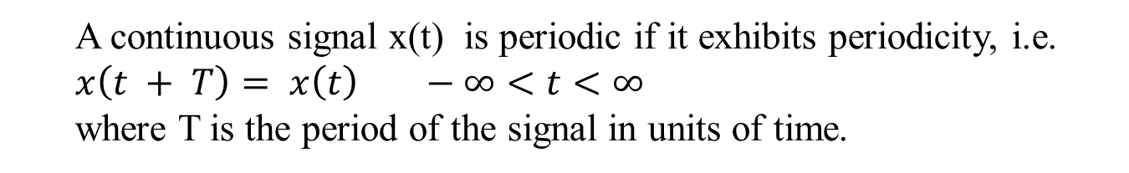
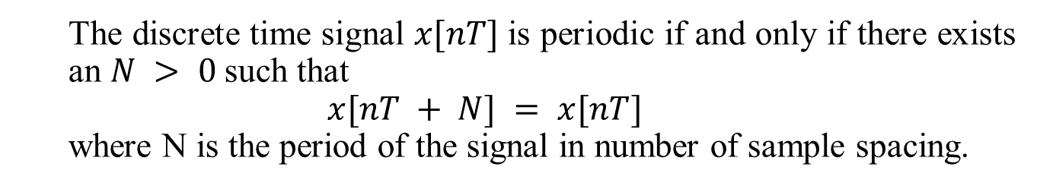
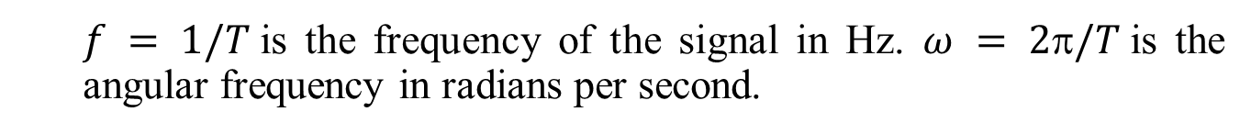
Periodic and Aperiodic Signals
A continuous signal x(t) is periodic if it exhibits periodicity, i.e.
$$x\left(t + T\right)= x\left(t\right) −∞<t<∞$$
where T is the period of the signal in units of time.
$f = 1/T$is the frequency of the signal in Hz. $ω = 2/T$is the angular frequency in radians per second.
The discrete time signal $x[nT]$is periodic if and only if there exists an $N > 0$such that
$$x[nT + N] = x[nT]$$
where N is the period of the signal in number of sample spacing.
Example:
If there is no values of T and N that satisfies the above equations ,the signal is called aperiodic (nonperiodic).
Frequency = 5 Hz or 10π rad/s
0
0.2
0.4

Slide 18
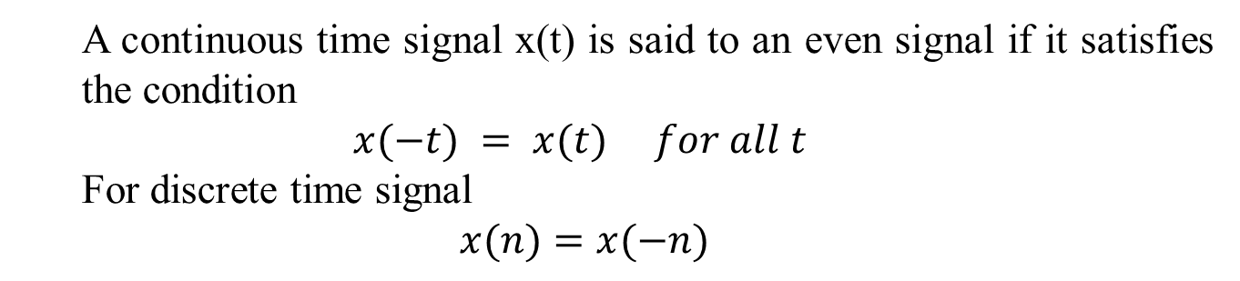
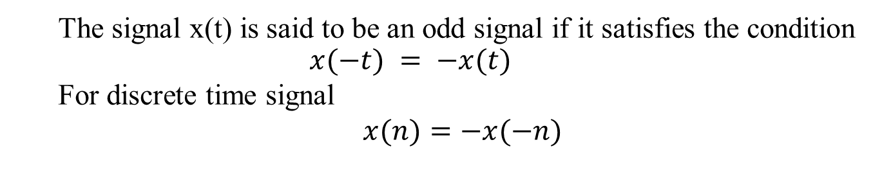
Even and Odd Signals
A continuous time signal x(t) is said to an even signal if it satisfies the condition
$$x(−t) = x(t) for all t$$
For discrete time signal
$$x(n)=x(−n)$$
The signal x(t) is said to be an odd signal if it satisfies the condition
$$x(−t) = −x(t)$$
For discrete time signal
$x(n)=−x(−n)$
In other words, even signals are symmetric about the vertical axis or time origin, whereas odd signals are anti-symmetric about the time origin. Similar remarks apply to discrete-time signals.
Example:
Even
Odd
Odd

Slide 19

Causal and Non-causal Signals
A continuous time signal is said to be causal if its amplitude is zero for negative time, i.e. , $x\left(t\right)=0 for t< 0$
For discrete time signal, the condition for causality is
$x\left(n\right)=0 for n< 0$
Anti-causal signal if the amplitude of signal is zero for positive time
For continuous time signal, $x\left(t\right)=0 for t> 0$
For discrete time signal$, x\left(n\right)=0 for n> 0$
A signal which is neither causal nor anti-causal is called non-causal signal.

Slide 20

Energy and Power Signals
A signal is referred to as an energy signal, if and only if the total energy of the signal satisfies the condition $0 < E < $
On the other hand, it is referred to as a power signal, if and only if the average power of the signal satisfies the condition $0 < P < $
An energy signal has zero average power, whereas a power signal has infinite energy.
Periodic signals and random signals are usually viewed as power signals, whereas signals that are both deterministic and non-periodic are energy signals.

Slide 21
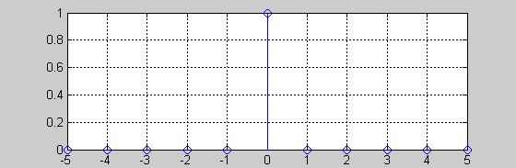
Some Elementary Discrete-Time Signals
1. Unit sample sequence

Slide 22
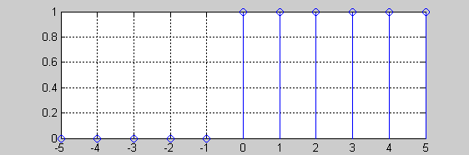
2.Unit step signal

Slide 23




3.Unit ramp signal
$$u_{r}(n)$$
$$⋯$$
$$n$$

Slide 24
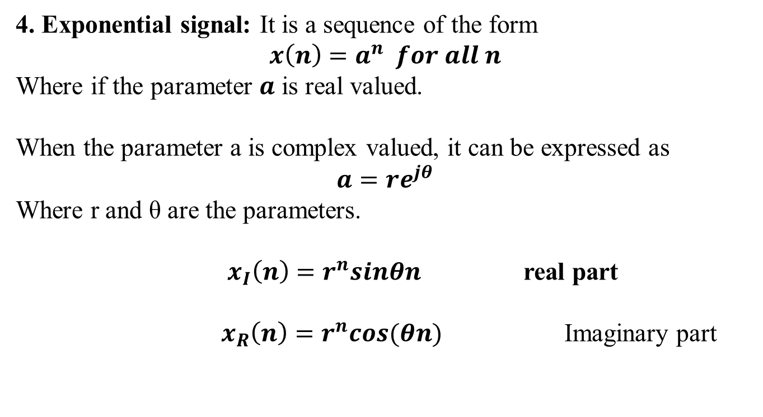
4. Exponential signal: It is a sequence of the form $$x\left(n\right)=a^{n} for all n$$
Where if the parameter $a$ is real valued.
When the parameter a is complex valued, it can be expressed as
$$a=re^{jθ}$$
Where r and θ are the parameters.
$x_{I}\left(n\right)=r^{n}sinθn$ real part
$x_{R}\left(n\right)=r^{n}cos(θn)$ Imaginary part

